Slide 1
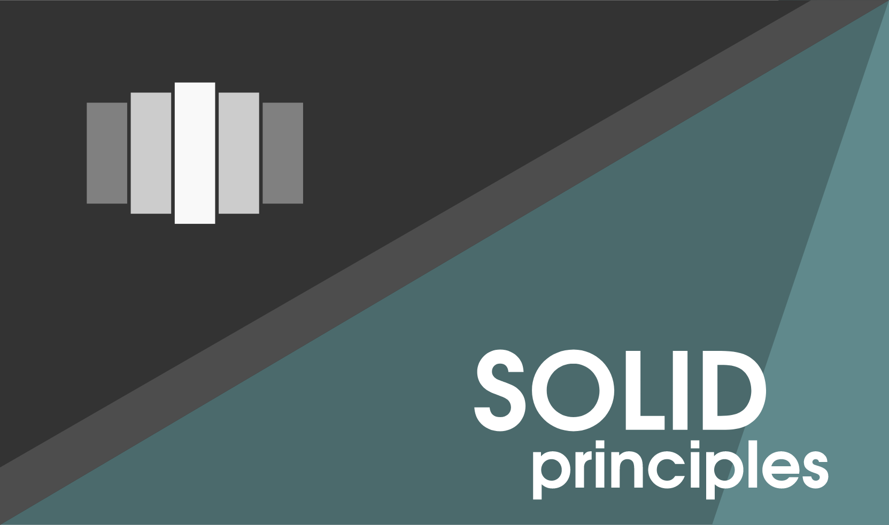

Slide 2
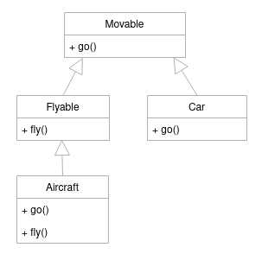
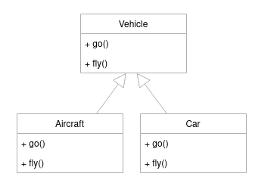
Interface Segregation Principle
‘’Many client-specific interfaces are better than one general-purpose interface”
The IS principles tell us that a class should only have the interface needed (SRP) and avoid methods that won’t work or that have no reason to be part of that class.
No code should be forced to depend on methods it does not use.
ISP splits interfaces that are very large into smaller and more specific ones so that clients will only have to know about the methods that are of interest to them.
An interface is a programming structure/syntax that allows the computer to enforce certain properties on an object (class).
A mixin is a class that provides method implementations for reuse by multiple related child classes.

Slide 3
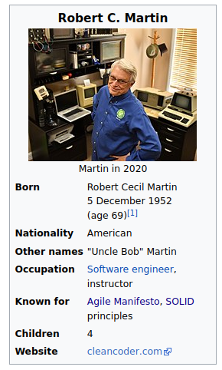
Solid Principles
Single-responsibility Principle
Open/Closed Principle
Liskov Substitution Principle
Interface Segregation Principle
Dependency Inversion Principle

Slide 4
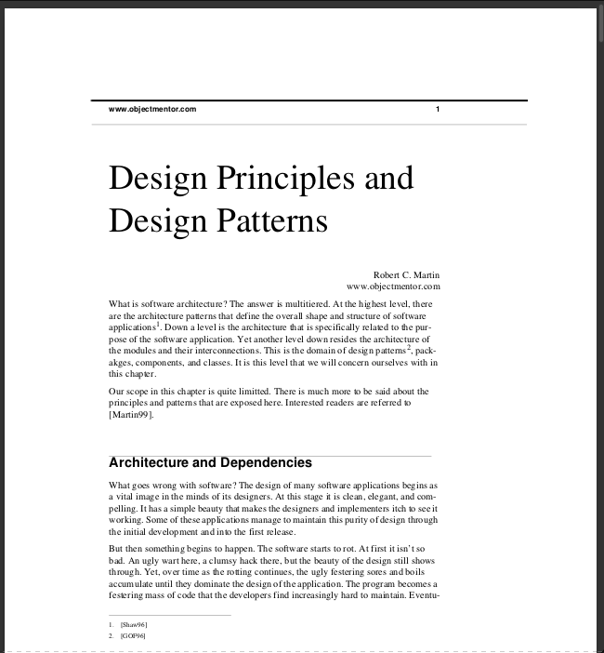
Single-responsibility Principle
‘’A class should have one, and only one, reason to change’’
In other words, every component of your code (in general a class, but also a function or a module) should have one and only one responsibility and it should encapsulate that part. As a consequence of that, there should be only a reason to change it.
The result is:
1- It is easier to localize errors. Any error in execution will point out to a smaller section of your code, accelerating your debug phase.
2- Any part of the code is reusable in other section of your code.
3- It is easier to create testing for each function of your code.

Slide 5
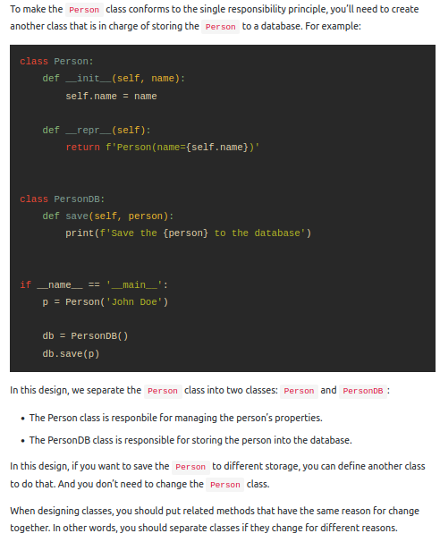
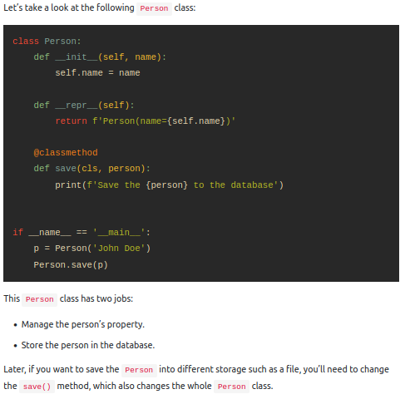

Slide 6
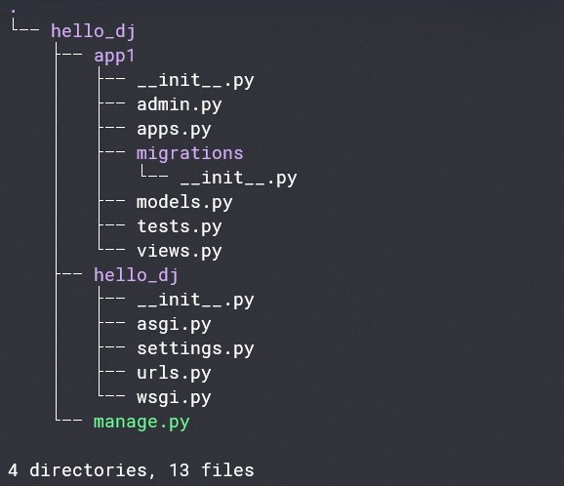
Single-responsibility Principle
Should have one and only one responsibility
and it should encapsulate that part

Slide 7
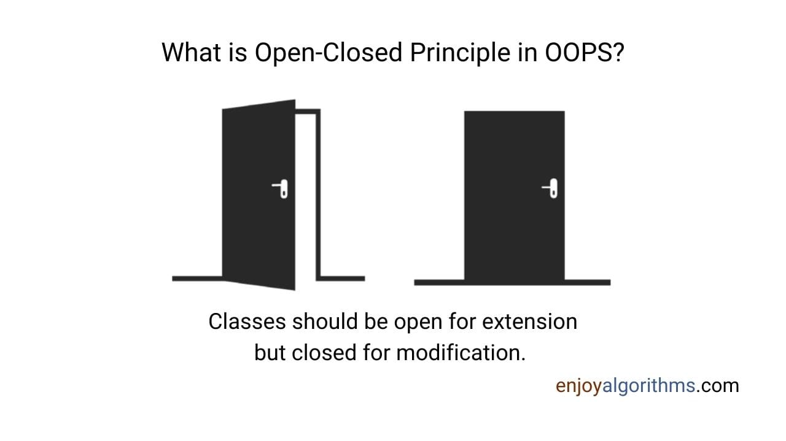
Open/Closed Principle
‘’Software entities, should be open for extension but closed for modification”
You should not need to modify the code you have already written to accommodate new functionality, but simply add what you now need.
This does not mean that you cannot change your code when the code premises needs to be modified, but that if you need to add new functions similar to the one present, you should not require to change other parts of the code.

Slide 8
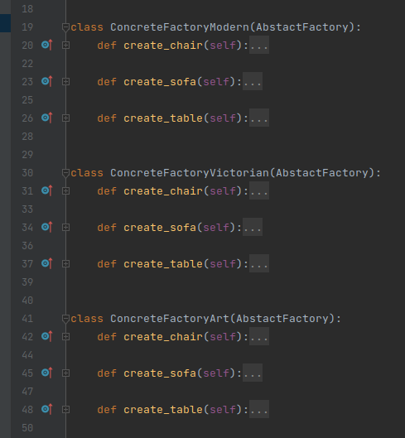
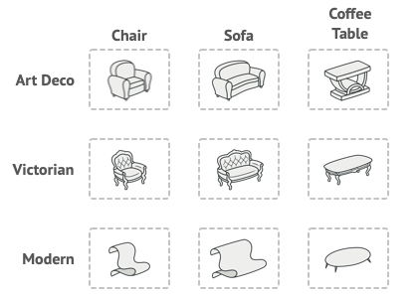
Open/Closed Principle

Slide 9
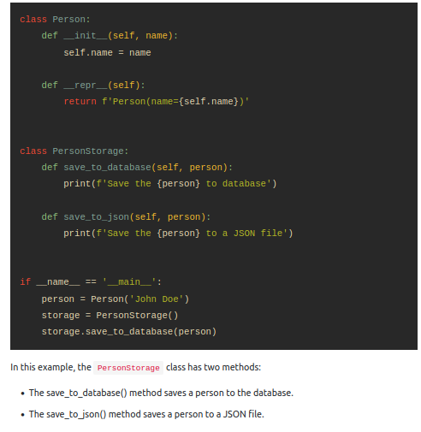
Open/Closed Principle
Later, if you want to save the Person’s object into an XML file, you must modify the PersonStorage class. It means that the PersonStorage class is not open for extension but not modification. Hence, it violates the open-closed principle.

Slide 10
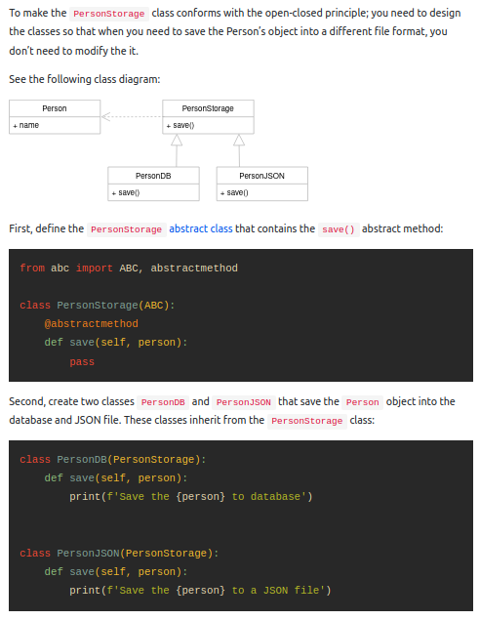
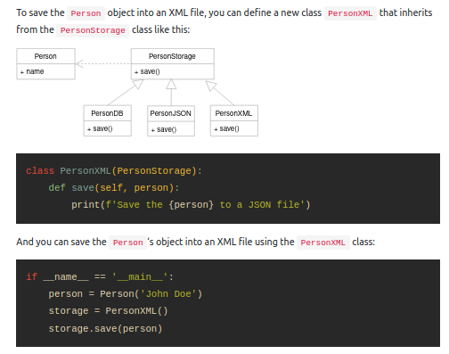

Slide 11
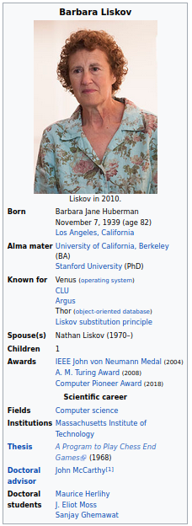
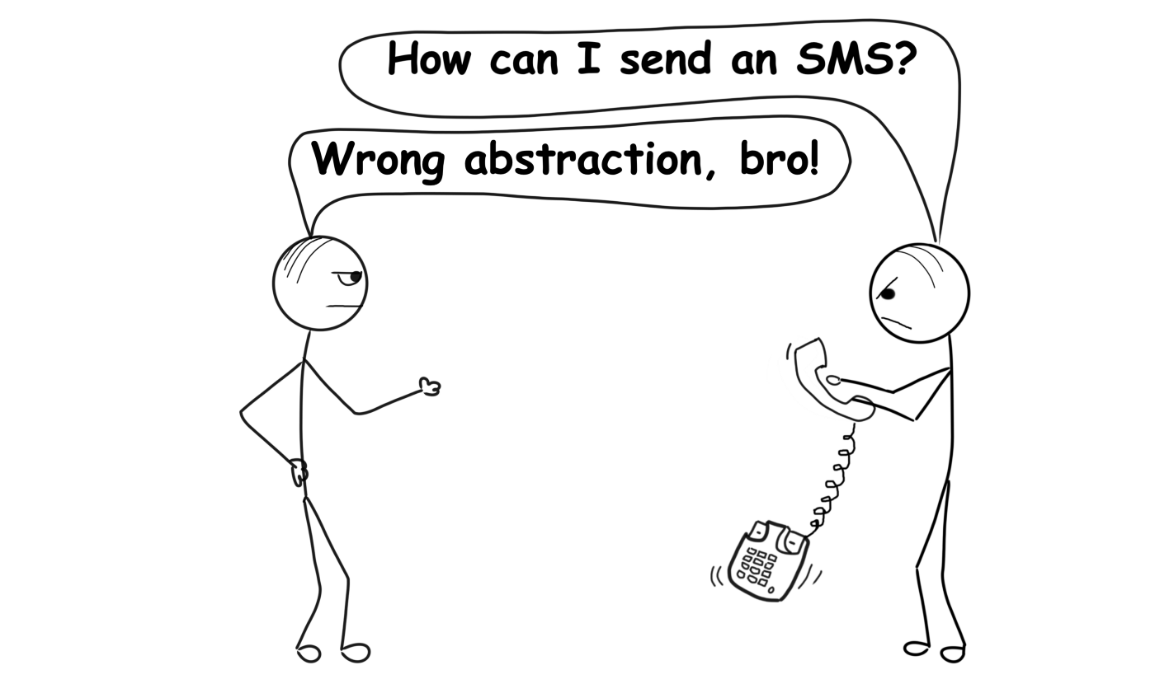
Liskov Substitution Principle
‘’Objects of a super-class shall be replaceable with objects of its sub-classes without breaking the application.”
If a subclass redefines a function also present in the parent class, a client-user should not be noticing any difference in behavior, and it is a substitute for the base class.
The LSP makes heavy use of inheritance and polymorphism and commonly leverages language features such as interfaces when multiple inheritances is not supported.

Slide 12
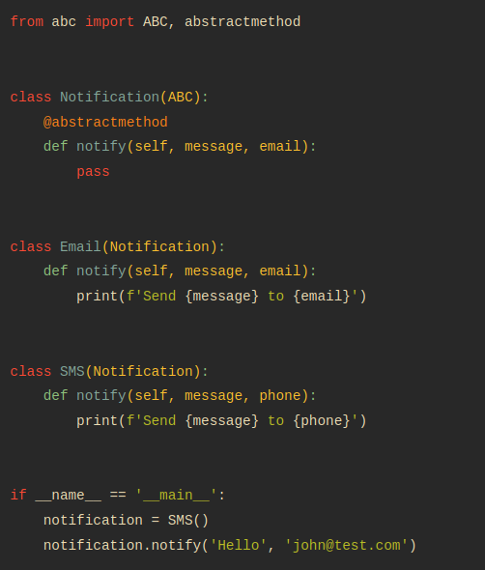
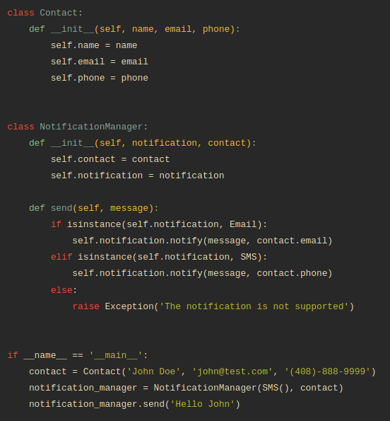
Liskov Substitution Principle

Slide 13
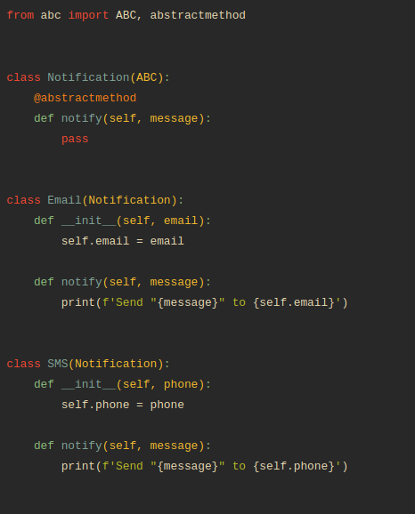
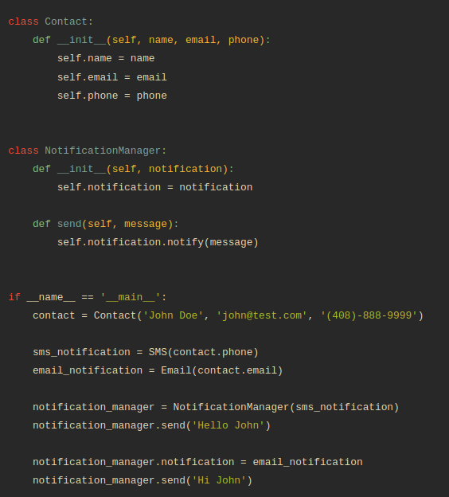
Liskov Substitution Principle
redefine the notify() method of the Notification class so that it doesn’t include the email parameter
add the email parameter to the __init__ method of the Email class
add the phone parameter to the __init__ method of the SMS class
change the NotificationManager class

Slide 14
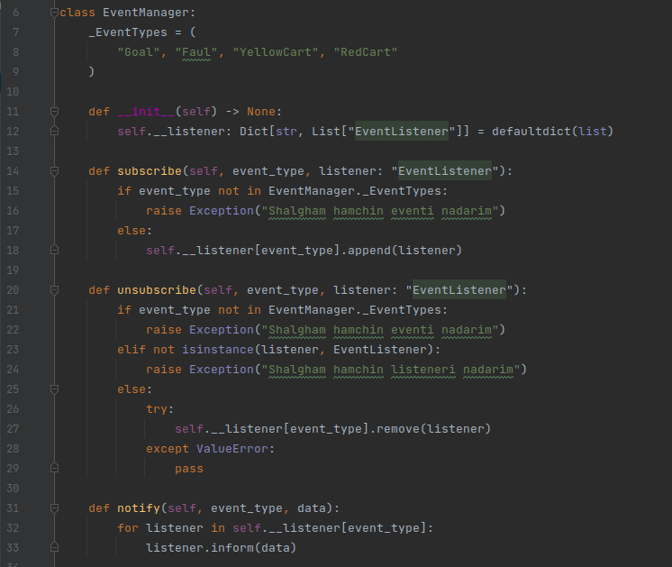
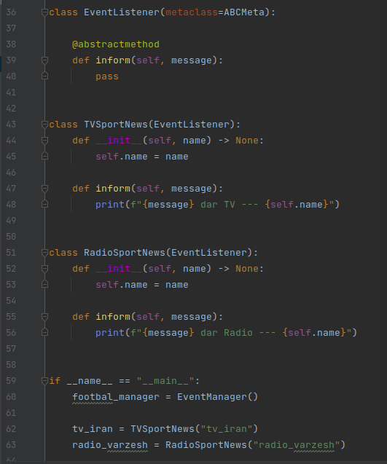
Liskov Substitution Principle
Objects of a super-class shall be replaceable with objects of its sub-classes

Slide 15
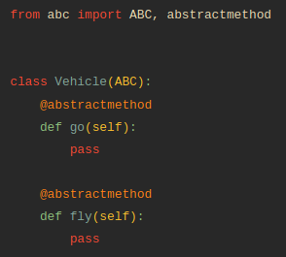
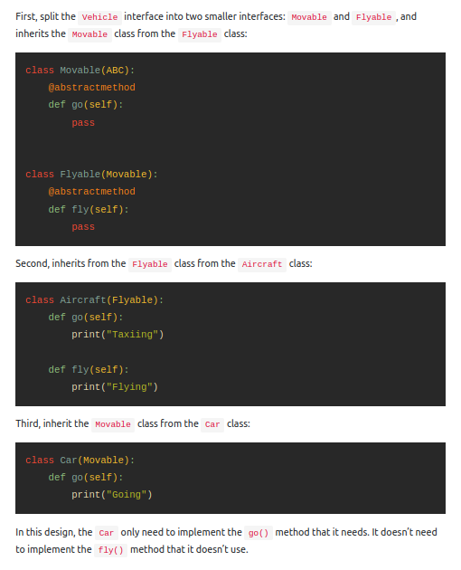
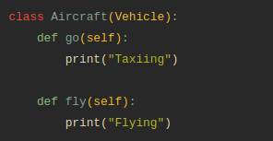
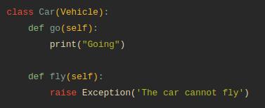
Interface Segregation Principle

Slide 16
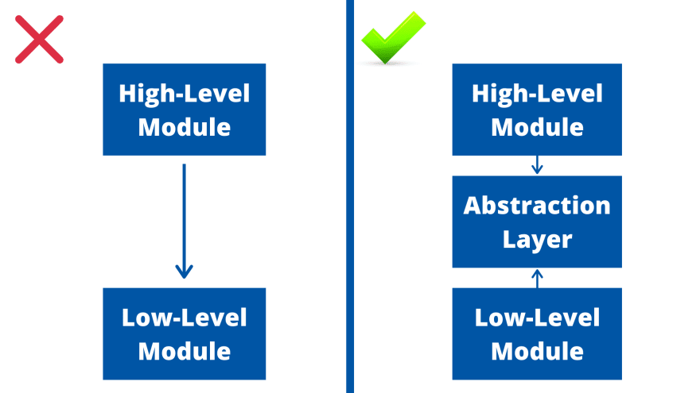
Dependency Inversion Principle
‘’High-level modules should not depend on low-level modules. Both should depend on abstractions
Abstractions should not depend on details. Details should depend on abstraction.”
The dependency inversion principle aims to reduce the coupling between classes by creating an abstraction layer between them.
High-level modules contain the important policy decisions and business models of an application – The identity of the application. Low-level modules contain detailed implementations of individual mechanisms needed to realize the policy.
A mixin is a class that provides method implementations for reuse by multiple related child classes.

Slide 17
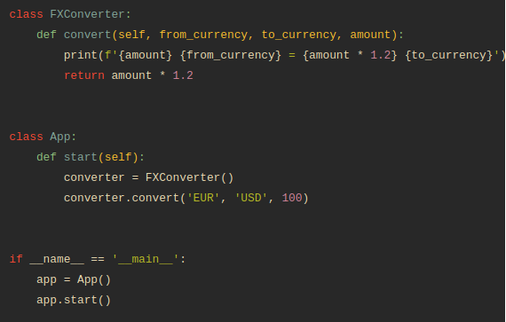

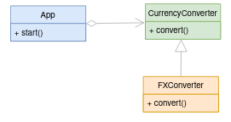
Dependency Inversion Principle
The App class has a start() method that uses an instance of the FXconverter class to convert 100 EUR to USD.
The App is a high-level module. However, The App depends heavily on the FXConverter class that is dependent on the FX’s API.
If the FX’s API changes, it’ll break the code. Also, if you want to use a different API, you’ll need to change the App class.
To Solve that, you define an interface and make the App dependent on it instead of FXConverter class.

Slide 18
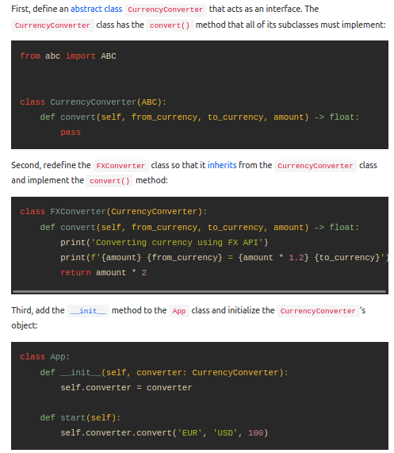
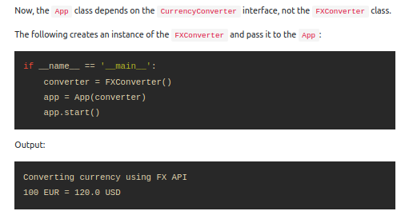
Dependency Inversion Principle

Slide 19
